Slide 1
3D Basic & OpenGLES 2.0
thuy.vuthiminh@gameloft.com
phong.caothai@gameloft.com
khiem.tranthien@gameloft.com
tam.la@gameloft.com

Slide 2
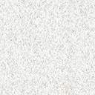
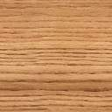
Content
Introduction
Rendering pipeline
Basic knowledge in Opengles 2.0?
Shader
Basic GLSL-ES
Basic Math
MVP matrices
Textures
Obj model
Shader effect: Skydome using cube mapping

Slide 3
Content
Introduction
Rendering pipeline
Shader
Basic GLSL-ES
Basic Math
MVP matrices
Textures
Obj model
Shader effect: Skydome using cube mapping

Slide 4
Basic Math
What is Texture?
Size of Texture
Text coordinate and Texel
Wrapping Modes
Filters
Mipmap
Coding
Textures concept

Slide 5
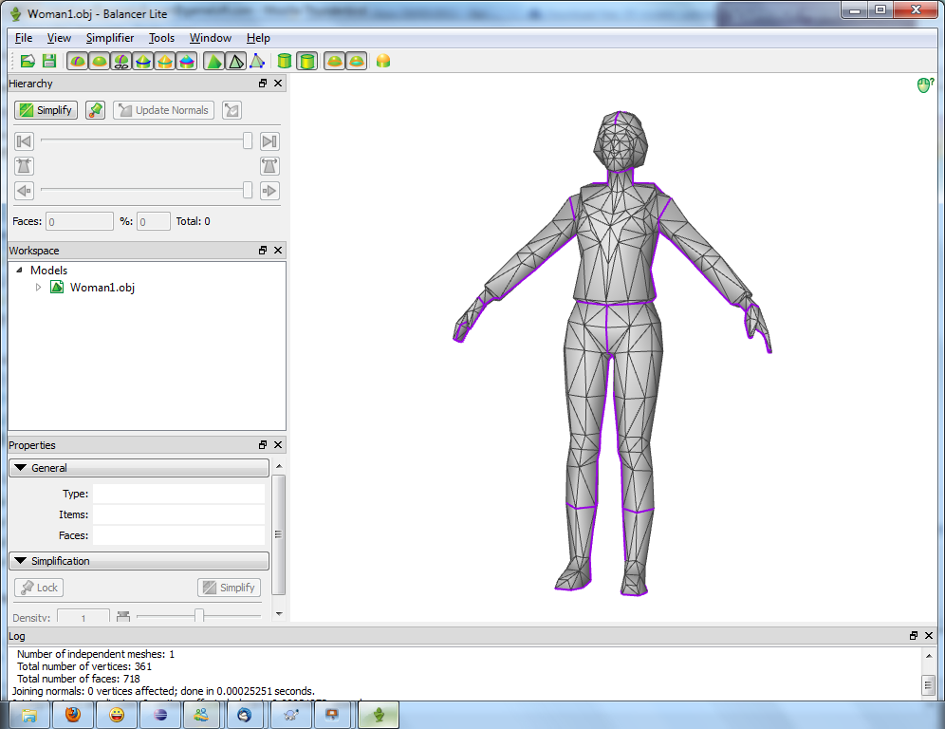
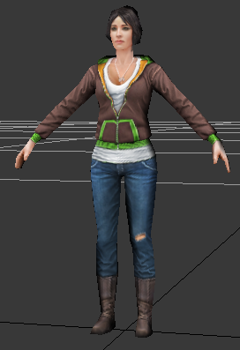
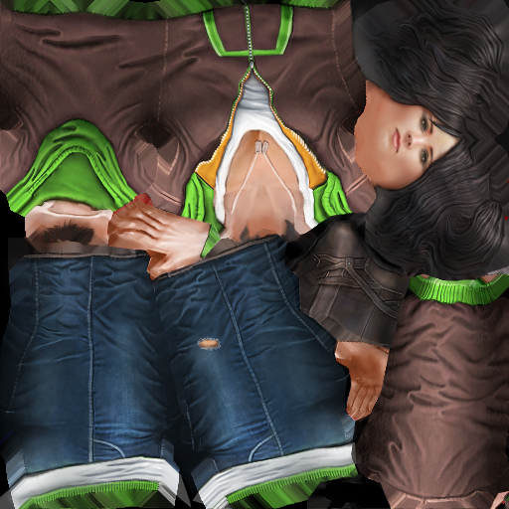
Textures
Texture is 2D Image applied on a 3D Object.
+
=

Slide 6
Textures
Each primitive on the 3D object will be map to a 2D Image
➔ Texture Mapping.
+

Slide 7

Size of Texture
Power of Two (POT):
Size (width, height) of a texture must be a power-of-two number, that mean it should be 1, 2, 4, 8, 16, 32, 64,….
None POT texture:
Some graphic cards support non-power-of-two textures.
For optimization and compatibility, we should use POT texture.
w
h

Slide 8
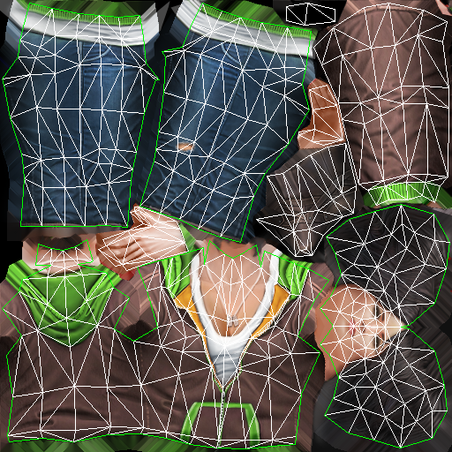
Text coordinate & Texel
UV or texture coordinate:
An attribute to describe the position of that vertex on the image
0, 0
u
Texel is a pixel on the texture.
T is a texel:
The coordinate of T on the image
Defined by (u, v)
The u, v is in [0, 1] range
v
T
1, 1

Slide 9

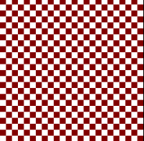

Wrapping Modes
Process to receive color on the image is called sampling
If pixel doesn’t receive a color by sampling, filling or mirroring the image depends on setting.
When UV is out of [0..1] range, to receive the color of that textel → options
glTexParameteri(GL_TEXTURE_2D, GL_TEXTURE_WRAP_S, wrap_s_option);
glTexParameteri(GL_TEXTURE_2D, GL_TEXTURE_WRAP_T, wrap_t_option);
Texture
WRAP_S: CLAMP
WRAP_T: CLAMP
WRAP_S: REPEAT
WRAP_T: REPEAT
WRAP_S: CLAMP
WRAP_T: REPEAT

Slide 10
Filters
u, v are float values
it is not always stay on a pixel in the image
→ we need a way to received the color from pixels on the images ?
→ Filters will solve this problems.
0, 0
u
v
T (u, v)
1, 1

Slide 11
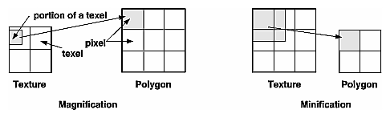
Filters: Minification and Magnification
Minification
More than one texel can cover a pixel
Magnification
More than one pixel can cover a texel
➔ Like when you zoom in/out the image, there must be a method to make the result.

Slide 12
Filters
Method to pick color from the texture with input u,v:
To set filtering options we use:
glTexParameteri(GL_TEXTURE_2D, GL_TEXTURE_MIN_FILTER, option);
glTexParameteri(GL_TEXTURE_2D, GL_TEXTURE_MAG_FILTER, option);
6 options:
GL_NEAREST: Nearest neighbor
GL_NEAREST_MIPMAP_NEAREST: Nearest neighbor with mipmapping
GL_LINEAR: Bilinear
GL_NEAREST_MIPMAP_LINEAR
GL_LINEAR_MIPMAP_NEAREST
GL_LINEAR_MIPMAP_LINEAR

Slide 13
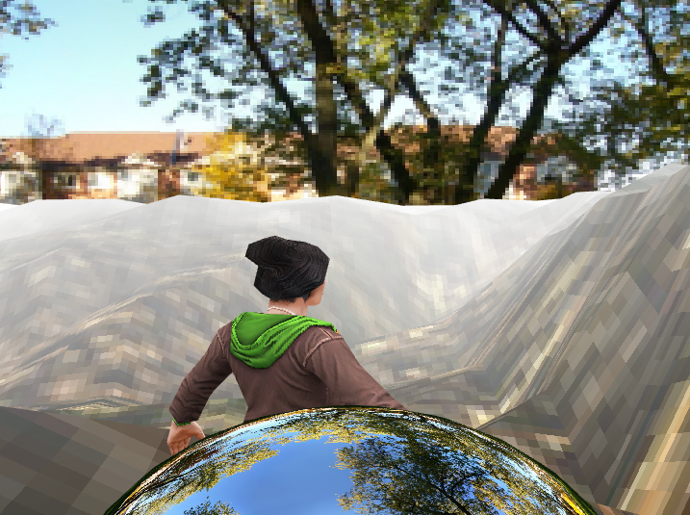
Filters
GL_NEAREST - Nearest neighbor: Pick the color of the nearest pixel on the texture image.
Fast method.
Generate a large amount of artifacts.
Pixel becomes big blocks in this scene
GL_NEAREST_MIPMAP_NEAREST - Nearest neighbor with mipmapping: Pick the color of the nearest pixel on the nearest mipmap:
Same to nearest neighbor but use mipmap.
Solve the antialiasing problem but we will still have blocks on our scene.

Slide 14
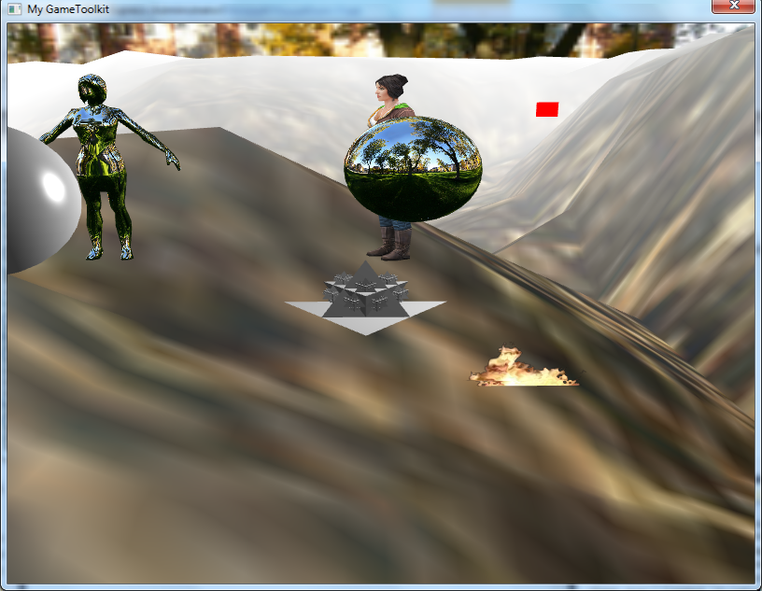
Filters (conts)
GL_LINEAR - Bilinear: Take four adjacent pixels to the texel to calculate the average color ➔ result color.
Notes:
- Vì cách generate mipmap bản thân nó đã solve vấn đề antialias.

Slide 15
Filter (conts)
GL_NEAREST_MIPMAP_LINEAR:
Take two adjacent texels on two nearest mipmaps by using GL_NEAREST, calculate the average value of the picked color → result color.
GL_LINEAR_MIPMAP_NEAREST:
Chose the nearest mipmap and use GL_LINEAR operation.
GL_LINEAR_MIPMAP_LINEAR:
Chose the two nearnest mipmaps to the texcel and pick the two texel using GL_LINEAR → calculate the average of those two values to get the final color.
Notes:
- Vì cách generate mipmap bản thân nó đã solve vấn đề antialias.

Slide 16
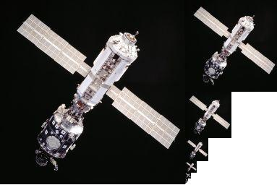
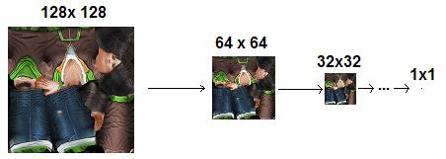
Mipmap
Mipmaps are pre-calcuated, optimized collection of image of a main texture
Advantages:
Increase rendering speed
Reduce anti-alias artifacts.
Lessens interpolation
Disadvantages:
Use much memory
Notes:
Tăng tốc độ xử lí là vì khi mimification -> xử lí với texture nhỏ hơn -> nhanh hơn.
Giảm răng cưa vì thuật toán tạo mipmaps đã có sẵn giảm hiệu ứng răng cưa.

Slide 17
Coding: How to use texture?
Generate the texture:
GLuint textureID;
glGenTextures(1, &textureID);
➔ A texture will be generated inside GPU.
Bind and load Texture data.
glBindTexture(GL_TEXTURE_2D, textureID);
glTexImage2D(GL_TEXTURE_2D, 0, RGBA, iWidth, iHeight, 0, RGBA, GL_UNSIGNED_BYTE, imageData);
➔ imageData is the image in RGBA format (4 byte / pixel).

Slide 18
Coding (conts)
Setting texture parameters:
glTexParameteri(GL_TEXTURE_2D,GL_TEXTURE_WRAP_S,GL_REPEAT);
glTexParameteri(GL_TEXTURE_2D,GL_TEXTURE_WRAP_T,GL_REPEAT);
For un-mipmap texture
glTexParameteri(GL_TEXTURE_2D,GL_TEXTURE_MIN_FILTER,GL_NEAREST);
glTexParameteri(GL_TEXTURE_2D,GL_TEXTURE_MAG_FILTER,GL_NEAREST);
For mipmap texture
glTexParameteri(GL_TEXTURE_2D, GL_TEXTURE_MIN_FILTER,
GL_NEAREST_MIPMAP_NEAREST );
// no GL_TEXTURE_MAG_FILTER with mipmap
glGenerateMipmap(GL_TEXTURE_2D);
We will have a texture inside the GPU for later use.

Slide 19
Coding (conts)
Writing the shader:
+ Add uv attribute.
attribute vec2 a_uv;
+ Add uv varying to pass it to the fragment shaders:
varying vec2 v_uv;
….
v_uv = a_uv;
+ Add uniform of the texture as a sampler2D.
uniform sampler2D u_texture;
+ Read the color value:
gl_FragColor = texture2D(u_texture, v_uv);
attribute vec4 a_position;
attribute vec2 a_uv;
varying vec2 v_uv;
void main()
{
gl_Position = a_position;
v_uv = a_uv;
}
uniform sampler2D u_texture;
varying vec2 v_uv;
void main()
{
gl_FragColor = texture2D(u_texture, v_uv);
}

Slide 20
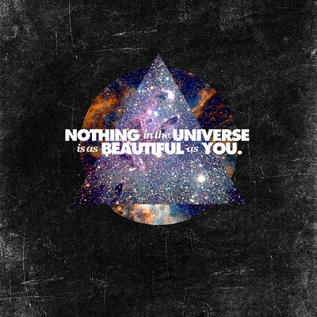
Coding (conts)
Define the Object and its attributes:
float vertices_pos[] = { … };
float texcoords_pos[] = {…};
Vertex attributes:
position.
uv.

Slide 21
Coding (conts)
Setting the texture uniform:
glBindTexture(GL_TEXTURE_2D, textureID);
glUniform1i(userData→u_texture, 0);
Command the GPU to draw the object:
glVertexAttribPointer(iVertexLoc, 3, GL_FLOAT, GL_FALSE, 0, vertices_pos);
glEnableVertexAttribArray(iVertexLoc);
glVertexAttribPointer(iTexcoordLoc, 2, GL_FLOAT, GL_FALSE, 0, texcoords_pos);
glEnableVertexAttribArray(iTexcoordLoc);
glDrawArrays(GL_TRIANGLES, 0, 3);

Slide 22
Texture: Practice
Suppose that I have below cube and picture
Write a code to map texuture on this cube
Result will see in the right picture
1
2
3
4
5
6
7
8

Slide 23
Content
Introduction
Rendering pipeline
Shader
Basic GLSL-ES
Basic Math
MVP matrices
Textures
Obj model
Shader effect: Skydome using cube mapping

Slide 24

Model
3D models/geometries are typically comprised of
Polygons
Verticies
Textures
Normal
which create the model's shape.
Normally, using file format with obj, md2, md5,… file extension

Slide 25
Obj File Format
Ex: If we want to draw a cube
8 vertices
6 planes, 2 triangles/plane
12 triangles ↔12 faces
1
2
3
4
5
6
7
8

Slide 26

Obj File Format
# # object Box01 # v -0.40 0.00 0.40 v -0.40 0.00 -0.40 v 0.40 0.00 -0.40 v 0.40 0.00 0.40 v -0.40 0.40 0.40 v 0.40 0.40 0.40 … # 8 vertices vn 0.00 -1.00 -0.00 vn 0.00 1.00 -0.00 vn 0.00 0.00 1.00 … # 6 vertex normals vt 1.00 0.00 0.00 vt 1.00 1.00 0.00 vt 0.00 1.00 0.00 … # 4 texture coords g Box01 usemtl 01___Default f 1/1/1 2/2/1 3/3/1 f 3/3/1 4/4/1 1/1/1 f 5/4/2 6/1/2 7/2/2 … # 12 faces
v: vertex (x, y, z)
vn: normal vector (x, y, z)
vt: texture coordination (u, v, p)
f: face, in order
vertex / textcoord / normal
Ex: A(-0.4, 0.0, 0.4)
Ex: $\vec{v}$(0.0, -1.0, -0.0)
Ex: (1.0, 0.0)
Ex:
f (-0.4, 0.0, 0.4 / 1.0, 0.0, 0.0 / 0.0, -1.0, -0.0
-0.4, 0.0, -0.4 / 1.0, 1.0, 0.0 / 0.0, -1.0, -0.0
0.4, 0.0, -0.4 / 0.0, 1.0, 0.0 / 0.0, -1.0, -0.0 )

Slide 27
Coding
# # object Box01 # v -0.40 0.00 0.40 v -0.40 0.00 -0.40 v 0.40 0.00 -0.40 v 0.40 0.00 0.40 v -0.40 0.40 0.40 v 0.40 0.40 0.40 … # 8 vertices vn 0.00 -1.00 -0.00 vn 0.00 1.00 -0.00 vn 0.00 0.00 1.00 … # 6 vertex normals vt 1.00 0.00 0.00 vt 1.00 1.00 0.00 vt 0.00 1.00 0.00 … # 4 texture coords g Box01 usemtl 01___Default f 1/1/1 2/2/1 3/3/1 f 3/3/1 4/4/1 1/1/1 f 5/4/2 6/1/2 7/2/2 … # 12 faces
Read from *.obj below info:
vertices_index[num_vertices x 3]
→ return the array contains all vertices
Ex: vertices_index[24] = {
-0.4, 0.0, 0.4, //vertex 1
-0.4, 0.0, -0.4, //vertex 2
0.4, 0.0, -0.4,…} //vertex 8
normal_index[num_normals x 3]
→ return the array contains all normal
Ex: normals_index[18] = {
1.0, 0.0, 0.0, //normal1
1.0, 1.0, 0.0, //normal 2
0.0, 1.0, 0.0,…} //normal 6

Slide 28
Coding
# # object Box01 # v -0.40 0.00 0.40 v -0.40 0.00 -0.40 v 0.40 0.00 -0.40 v 0.40 0.00 0.40 v -0.40 0.40 0.40 v 0.40 0.40 0.40 … # 8 vertices vn 0.00 -1.00 -0.00 vn 0.00 1.00 -0.00 vn 0.00 0.00 1.00 … # 6 vertex normals vt 1.00 0.00 0.00 vt 1.00 1.00 0.00 vt 0.00 1.00 0.00 … # 4 texture coords g Box01 usemtl 01___Default f 1/1/1 2/2/1 3/3/1 f 3/3/1 4/4/1 1/1/1 f 5/4/2 6/1/2 7/2/2 … # 12 faces
texcoords_index[num_textcoord x 3]
→ return the array contains all textcoord
Ex: texcoords_index[24] = {
1.0, 0.0, 0.0, //textcoord 1
1.0, 1.0, 0.0, // textcoord 2
0.0, 1.0, 0.0,…} // textcoord 4

Slide 29
Coding
f 1/1/1 2/2/1 3/3/1
f 3/3/1 4/4/1 1/1/1
f 5/4/2 6/1/2 7/2/2
…
This means:
f vertex 1 / textcoord 1 / normal 1 vertex 2 / textcoord 2 / normal 2 vertex 3 / textcoord 3 / normal 3
f vertex 3 / textcoord 3 / normal 1 vertex 4 / textcoord 4 / normal 1 vertex 1 / textcoord 1 / normal 1
f vertex 5 / textcoord 4 / normal 2 vertex 6 / textcoord 1 / normal 2 vertex 7 / textcoord 2 / normal 2
Vertex1
Vertex2
Vertex3

Slide 30
Coding
# # object Box01 # v -0.40 0.00 0.40 v -0.40 0.00 -0.40 v 0.40 0.00 -0.40 v 0.40 0.00 0.40 v -0.40 0.40 0.40 v 0.40 0.40 0.40 … # 8 vertices vn 0.00 -1.00 -0.00 vn 0.00 1.00 -0.00 vn 0.00 0.00 1.00 … # 6 vertex normals vt 1.00 0.00 0.00 vt 1.00 1.00 0.00 vt 0.00 1.00 0.00 … # 4 texture coords g Box01 usemtl 01___Default f 1/1/1 2/2/1 3/3/1 f 3/3/1 4/4/1 1/1/1 f 5/4/2 6/1/2 7/2/2 … # 12 faces
f 1/1/1 2/2/1 3/3/1
f 3/3/1 4/4/1 1/1/1
f 5/4/2 6/1/2 7/2/2
…
indices[12 x 3] = {
1, 1, 3, // first triangle
3, 4, 1, // second triangle
5, 6, 7, // third triangle
…}
vertices_array[num_face x 3 x 3] = {
-0.4, 0.0, 0.4, -0.4, 0.0, -0.4, 0.4, 0.0, 0.4, // first triangle
0.4, 0.0, -0.4, 0.4, 0.0, 0.4, -0.4, 0.0, 0.4, // second triangle
-0.4, 0.4, 0.4, 0.4, 0.4, 0.4, x, y, z, // third triangle
…}
vertices_index[6]
x
y
z

Slide 31
Coding
float vertices_array[] = {…} //array of vertices
float texcoords_array[] = {…}
float normals_array[] = {…}
int iNumFace = … //num of face / triangle
glVertexAttribPointer(iVertexLoc, 3, GL_FLOAT, GL_FALSE, 0, vertices_array);
glEnableVertexAttribArray(iVertexLoc);
glVertexAttribPointer(iTexco ordLoc, 2, GL_FLOAT, GL_FALSE, 0, texcoords_array);
glEnableVertexAttribArray(iTexcoordLoc);
glDrawArrays(GL_TRIANGLES, 0, iNumFace * 3);

Slide 32
Content
Introduction
Rendering pipeline
Shader
Basic GLSL-ES
Basic Math
MVP matrices
Textures
Obj model
Shader effect: Skydome using cube mapping

Slide 33
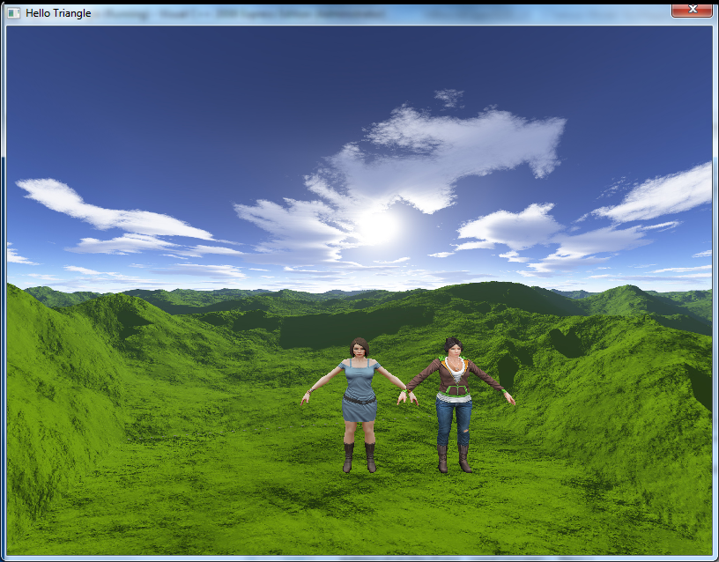
Skymapping: Sky dome
Called Cube mapping

Slide 34
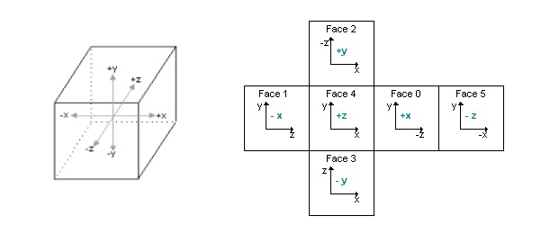
Sky mapping: Sky dome
An effect known as environment mapping
A cube (sky box) or a sphere (sky sphere) that encapsulate the whole scene composed of six 2D textures
A camera is placed in the center of the scene
Image 26 : Cube Map Unwrap

Slide 35
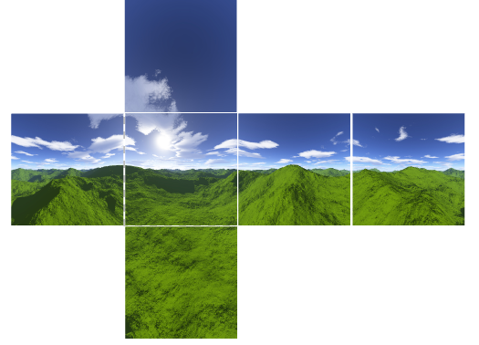
Sky mapping: Sky dome
A cubic texture included 6 sides of a cube
An image of the scene is captured from each of the six axis directions (+X, –X, +Y, –Y, +Z, –Z) and stored in each cube face
GL_TEXTURE_CUBE_MAP_POSITIVE_X,
GL_TEXTURE_CUBE_MAP_NEGATIVE_X, GL_TEXTURE_CUBE_MAP_POSITIVE_Y,
GL_TEXTURE_CUBE_MAP_NEGATIVE_Y, GL_TEXTURE_CUBE_MAP_POSITIVE_Z,
GL_TEXTURE_CUBE_MAP_NEGATIVE_Z

Slide 36
Sky mapping: Coding
Vertex Cube shader | Fragment Cube shader
attribute vec4 a_CubeVertexPos; uniform mat4 u_CubeMVPMatrix; varying vec4 v_pos; void main(void) { gl_Position = u_CubeMVPMatrix * a_CubeVertexPos; gl_Position.z = 1 - 0.0001; v_pos = a_CubeVertexPos; } | precision mediump float; uniform samplerCube u_samplerCubeMap; varying vec4 v_pos; void main(void) { gl_FragColor = textureCube( u_samplerCubeMap, v_pos.xyz); }
Calculate the position of the vertex, set it's z position to be the on the farthest z possible.

Slide 37
Coding (conts)
Official way | Optimized way
// Generate a texture object glGenTextures(1, &textureId); // Bind the texture object glBindTexture(GL_TEXTURE_CUBE_MAP, textureId); // Load the cube face - Positive X glTexImage2D(GL_TEXTURE_CUBE_MAP_POSITIVE_X, 0, GL_RGB, 512, 512, 0, GL_RGB, GL_UNSIGNED_BYTE, &cubePixels[0]); // Load the cube face - Negative X glTexImage2D(GL_TEXTURE_CUBE_MAP_NEGATIVE_X, 0, GL_RGB, 512, 512, 0, GL_RGB, GL_UNSIGNED_BYTE, &cubePixels[1]); // Load the cube face - Positive Y glTexImage2D(GL_TEXTURE_CUBE_MAP_POSITIVE_Y, 0, GL_RGB, 512, 512, 0, GL_RGB, GL_UNSIGNED_BYTE, &cubePixels[2]); // Load the cube face - Negative Y glTexImage2D(GL_TEXTURE_CUBE_MAP_NEGATIVE_Y, 0, GL_RGB, 512, 512, 0, GL_RGB, GL_UNSIGNED_BYTE, &cubePixels[3]); // Load the cube face - Positive Z glTexImage2D(GL_TEXTURE_CUBE_MAP_POSITIVE_Z, 0, GL_RGB, 512, 512, 0, GL_RGB, GL_UNSIGNED_BYTE, &cubePixels[4]); // Load the cube face - Negative Z glTexImage2D(GL_TEXTURE_CUBE_MAP_NEGATIVE_Z, 0, GL_RGB, 512, 512, 0, GL_RGB, GL_UNSIGNED_BYTE, &cubePixels[4]); | // Generate a texture object glGenTextures(1, &textureId); glBindTexture(GL_TEXTURE_CUBE_MAP, textureId); for (int i=0; i<6; i++) { glTexImage2D ( GL_TEXTURE_CUBE_MAP_POSITIVE_X+i, 0, GL_RGB, 512, 512, 0, GL_RGB, GL_UNSIGNED_BYTE, &cubePixels[i] ); }

Slide 38
Sky mapping: Coding (conts)
glBindTexture (GL_TEXTURE_CUBE_MAP, textureId); glEnableVertexAttribArray ( iPosVertexLoc ); glVertexAttribPointer (iPosVertexLoc, 3, GL_FLOAT, GL_FALSE, 0, m_aVerticesArray); glDrawArrays (GL_TRIANGLES, 0, 36);

Slide 39
Practice
Go to:
\\sai-data01\Documents\Specialized\Programming\Training\01. MegaTraining\Basic\3D & OpenGL\GLES 2.0 workshop\
File: OpenGL_Practice_gles_2.0.pdf
Do part 3.

Slide 40
Any question?

